Slide 1
MLMQ Mat Luke Message Queuing
Advanced Systems Lab – Milestone 1
Matthias Ganz & Lukas Elmer
HS 13/14
ETHZ

Slide 2


Slide 3
Agenda
Design
Experiments
Lessons Learned about the System

Slide 4
Agenda
Design
Overview
Middleware
Database Interface
Client Interface
Experiments
Setup
Summary
Results
2h Trace
Lessons Learned about the System

Slide 5
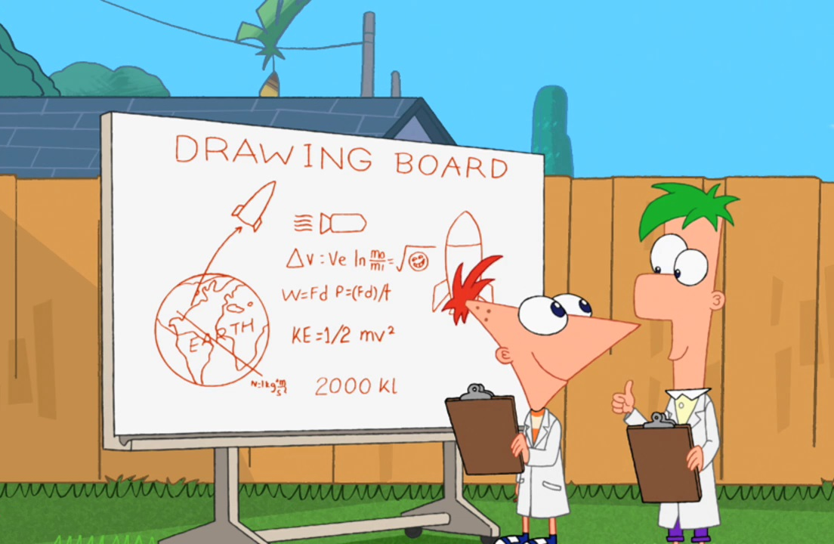
Design

Slide 6
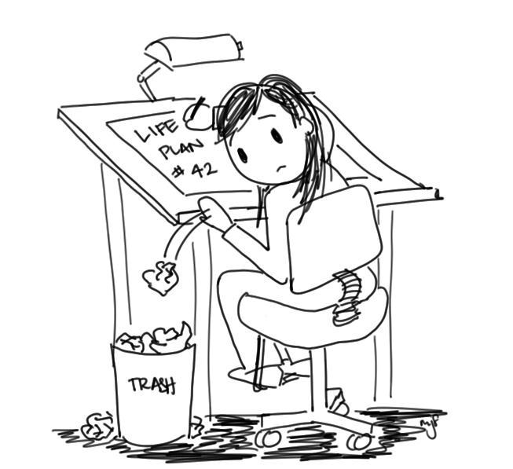
Design

Slide 7

Design

Slide 8

Design

Slide 9
Design – Overview
Client
Client
Client
Middleware
Database
Client
Client
Client
TCP IP Sockets
Middleware
JDBC
Client
Client
Client
Middleware

Slide 10
Design – Middleware
Middleware
NIO
Request Queue
Worker Pool
DB Connection Pool
Client
Database
Client
Response Queue
Client
Buffer Pool
Notes:
NIO: Expensive:
Create network connections
Pools: Expensive:
Create threads
Establish DB connections
Create objects
Queues: concurrent, workers work independently

Slide 11
Design – Middleware
Middleware
Request Queue
NIO
DB Connection Pool
Client
Database
Client
Client
Client
Client
Worker
Response Queue
Buffer Pool
Notes:
NIO: Expensive:
Create network connections
Pools: Expensive:
Create threads
Establish DB connections
Create objects
Queues: concurrent, workers work independently

Slide 12
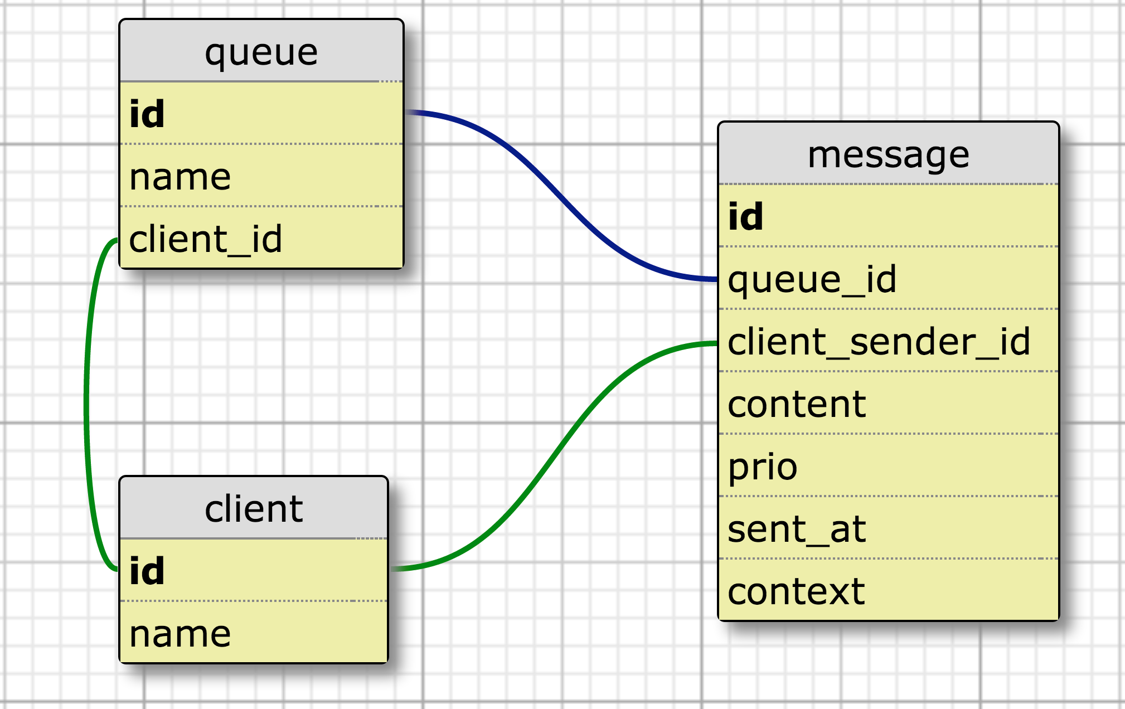
Design – Database
Notes:
KISS
Context: For request – response
Otherwise would use two fields is_request_response and message_id
No receiver_id: Every client owns a private queue

Slide 13
Design – Database Interface
Indices
Queue: client_id
Client: name
Message: queue_id, prio, sent_at, client_sender_id, context
Important stored procedures
peekMessage
dequeueMessage
Locks a specific record for dequeuing
Prepared statements & auto commit

Slide 14
Design – Client Interface
ClientDto register()
ClientDto lookupClient(String clientName)
QueueDto lookupClientQueue(long clientId)
QueueDto createQueue(String queueName)
QueueDto lookupClientQueue(String queueName)
void deleteQueue(long id)
void sendMessage(long queueId, byte[] content, int prio)
void sendMessage(long[] queueIds, byte[] content, int prio)
void sendMessageToClient(long clientId, byte[] content, int prio)
long sendRequestToClient(long client, byte[] content, int prio)
long sendResponseToClient(long clientId, long context, byte[] content, int prio)
int queuesWithPendingMessages(List<QueueDto> queues, int maxNumQueues)
MessageDto peekMessage(MessageQueryInfoDto messageQueryInfo)
MessageDto dequeueMessage(MessageQueryInfoDto messageQueryInfo)

Slide 15

Experiments

Slide 16
Experiments – Summary
Stability
2h Trace
Best configuration
Throughput vs. response time
2^{k} Test
Bottlenecks, optimization Points
Which component spends how much time
System limit
Load tests

Slide 17
Experiments – Setup
Client
Client
Client
Middleware
Database
Client
Client
Client
Middleware
Client
Client
Client
Middleware
?
Config

Slide 18


Experiments – Setup
Client
Client
Client
Middleware
Database
Client
Client
Client
Middleware
Client
Client
Client
Middleware
Config
Testmaster
Notes:
Ruby

Slide 19
Experiments – Setup
Client
Client
Client
Middleware
Database
Client
Client
Client
Middleware
Client
Client
Client
Middleware
Testmaster
Logs

Slide 20
Experiments – Setup
Client
Client
Client
Middleware
Database
Client
Client
Client
Middleware
Client
Client
Client
Middleware
Testmaster
Logs
Plots & Statistics

Slide 21
Experiments – Sequential Test
C
C
C
M
DB
C
C
C
M
C
C
C
M
Testmaster

Slide 22
Experiments – Parallel Tests
C
C
C
C
C
C
C
M
C
M
C
M
DB
DB
DB
C
C
C
C
C
C
C
M
C
M
C
M
C
C
C
C
C
C
C
M
C
M
C
M
Testmaster 1
Testmaster 2
Testmaster 2
Cannot to 20 Amazon EC2 instances Request to Increase Amazon EC2 Instance Limit

Slide 23
Experiments – 2h Trace without startup / cooldown time, throughput
Notes:
We turned off one middleware after 90 minutes.
Balken aufgelöst ca. 1 min
Konfidenzintervall
Balken Throughput und response time
Evt. Mit 2 => mit/ohne Abschneiden

Slide 24
Experiments – 2h Trace with 4 minutes startup / cooldown time, throughput
Notes:
We turned off one middleware after 90 minutes.
Balken aufgelöst ca. 1 min
Konfidenzintervall
Balken Throughput und response time
Evt. Mit 2 => mit/ohne Abschneiden

Slide 25
Experiments – 2h Trace without startup / cooldown time, response time
Notes:
Balken aufgelöst ca. 1 min
Konfidenzintervall
Balken Throughput und response time
Evt. Mit 2 => mit/ohne Abschneiden

Slide 26
Experiments – 2h Trace with 4 minutes startup / cooldown time, response time
Notes:
Balken aufgelöst ca. 1 min
Konfidenzintervall
Balken Throughput und response time
Evt. Mit 2 => mit/ohne Abschneiden

Slide 27
Experiments – 2h Trace
For the 2h Test configuration
For 95% of all sendMessage requests, the response time will be under TODO ms
For 95% of all peekMessage requests, the response time will be under TODO ms
For 95% of all dequeueMessage requests, the response time will be under TODO ms
Notes:
Diagramm in the report

Slide 28
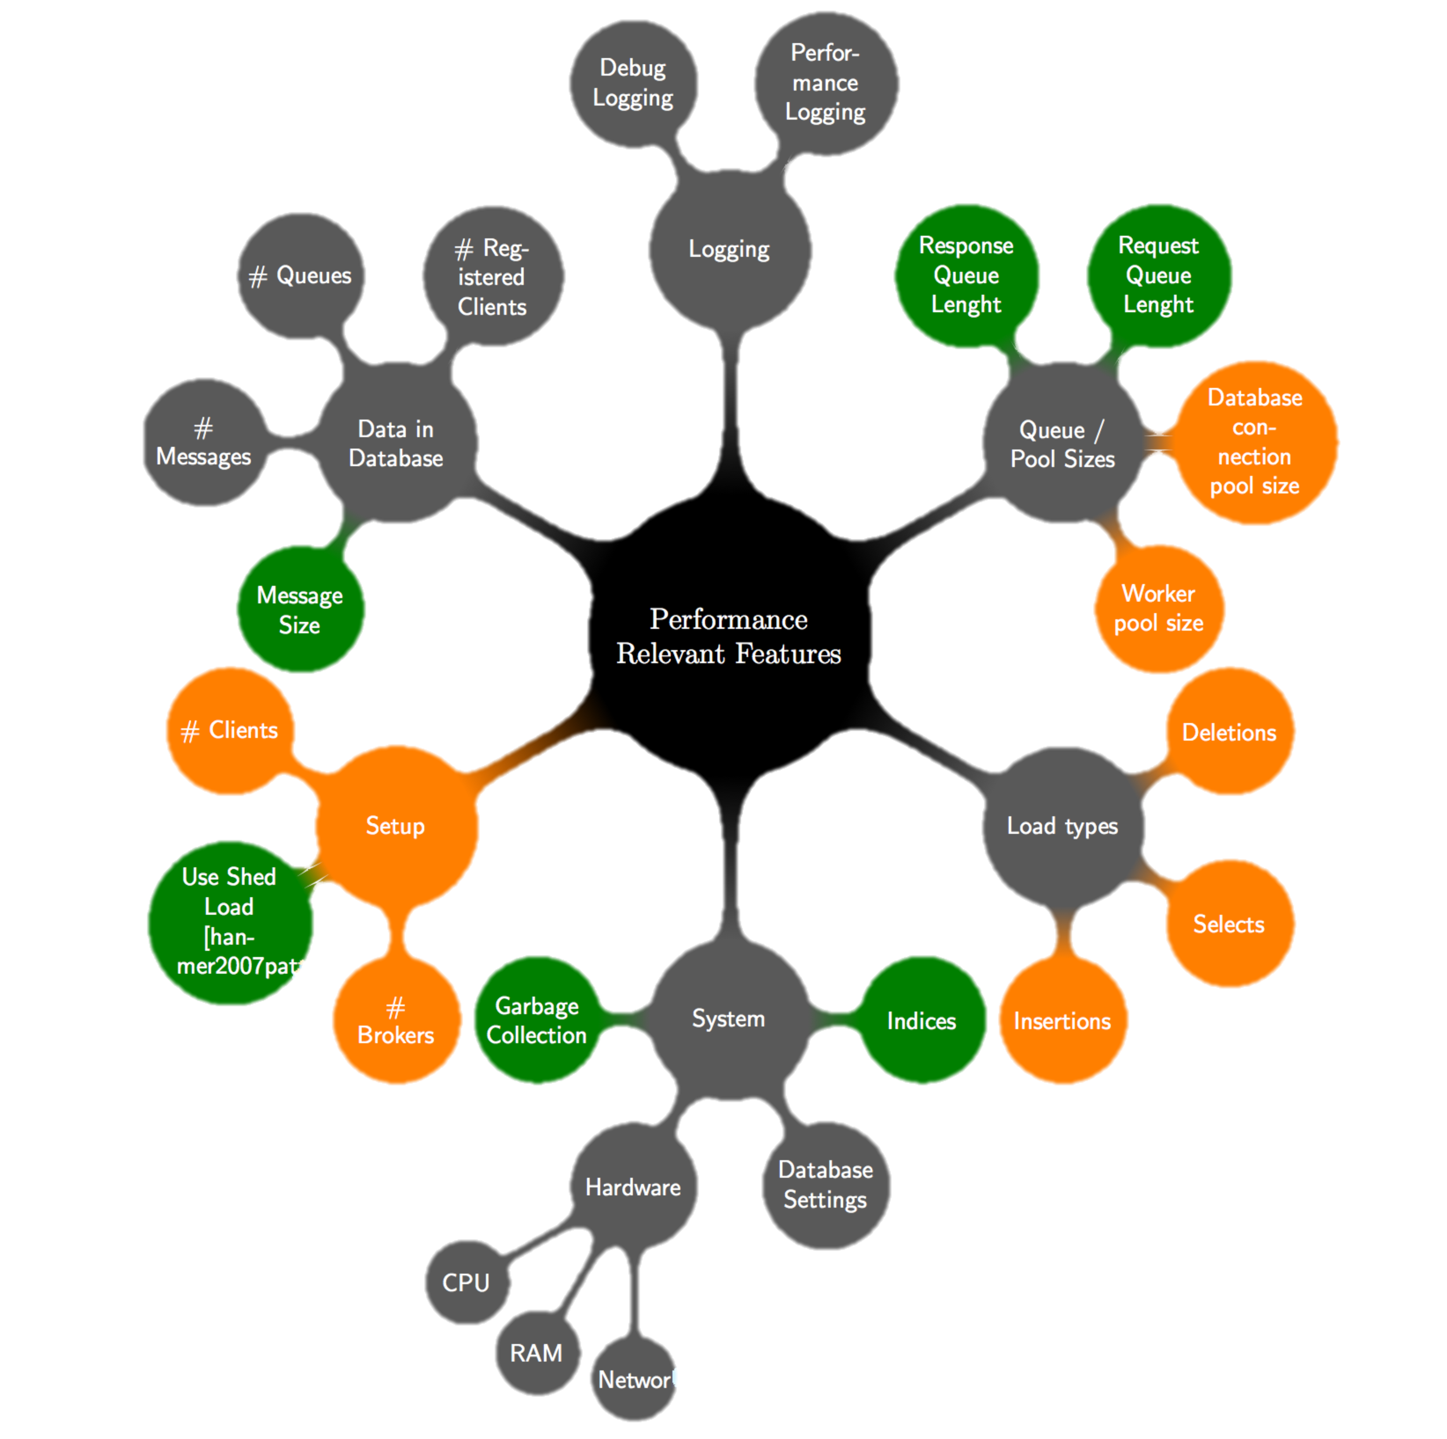
Experiments – Factors

Slide 29
Experiments – Primary Factors
# Clients
# Brokers
DB Connection Pool Size
Worker Pool Size
2^{k} Test

Slide 30
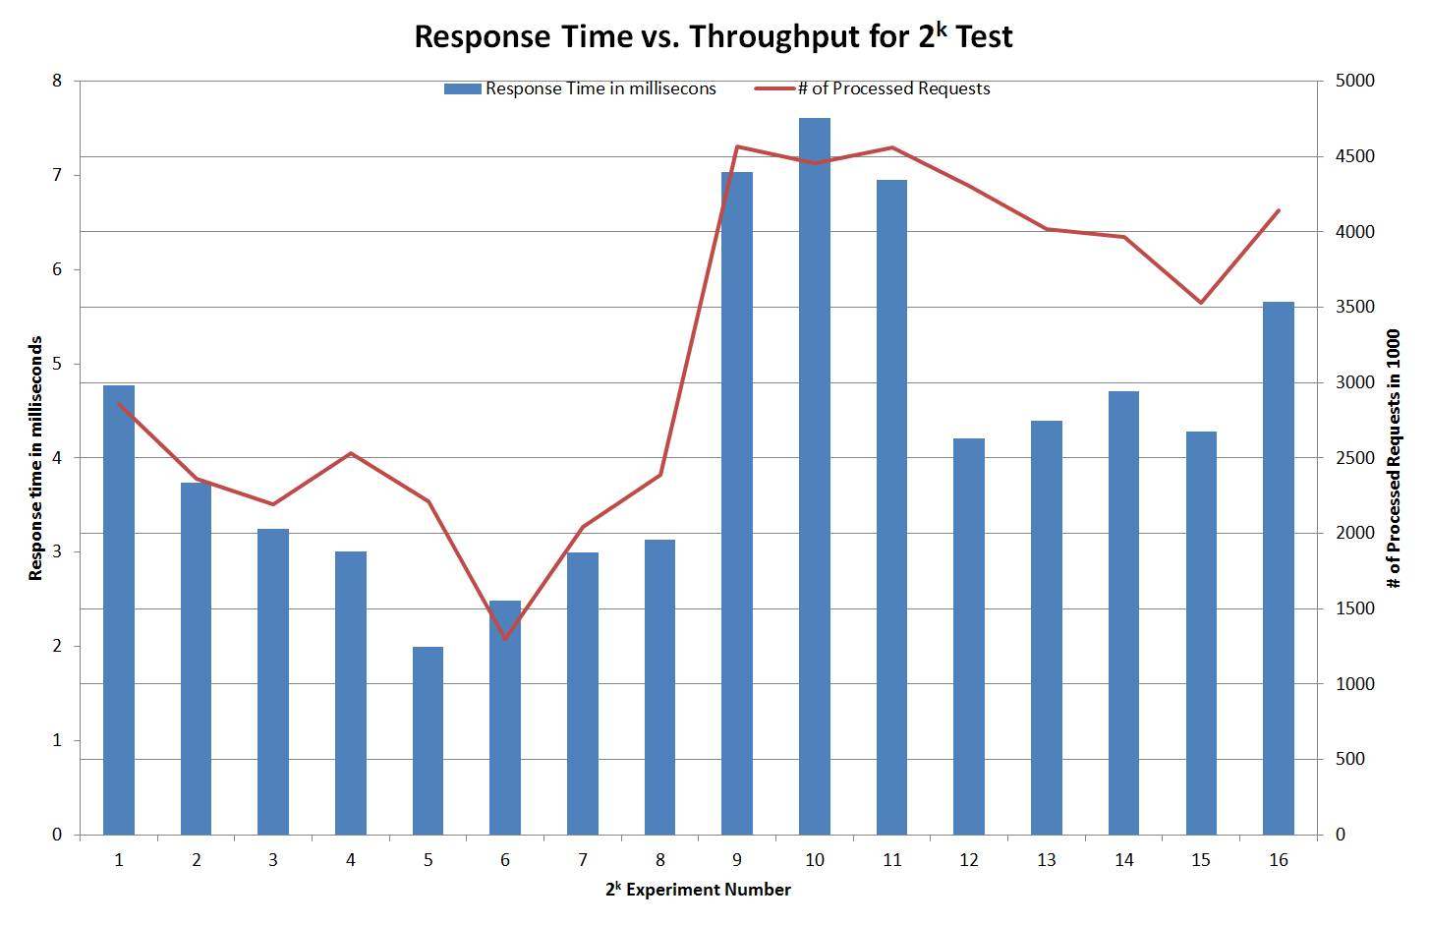
Experiments – Results: 2^{k} Test

Slide 31
Experiments – Results: 2^{k} Test
Response time
TODO: insert response time

Slide 32
Experiments – Results

Slide 33
Experiments – Results

Slide 34
Experiments – Results

Slide 35
Experiments – Incremental Load Test, Response Time

Slide 36
Experiments – Incremental Load Test, Throughput

Slide 37

Lessons Learned about the System

Slide 38
Lessons Learned about the System
Improvements during this milestone
Response time stability
Throughput
Saturated system
=> higher throughput
=> higher variance in response time
Potential bottleneck
Database

Slide 39

Lessons Learned about the System

Slide 40

Lessons Learned about the System

Slide 41

Lessons Learned about the System

Slide 42

Lessons Learned about the System

Slide 43
Questions
Thank you

